Slide 1




Strategic Insights
Venture into a new Cellphone Market

Slide 2





Agenda
O b j e c t i v e
B a c k g r o u n d
Pr o c e s s F l o w
A n a l y s i s a n d I n s i g h t s
A c t i o n I t e m s
A p p e n d i x

Slide 3
Objective
To p r o v i d e
the b u s i n e s s w i t h some m a j o r i n s i g h t s
i n t o the m o b i l e p h o n e i n d u s t r y.
To u n d e r s t a n d t h e
b u s i n e s s c o m p e t i t o r s a n d
p r e f e r e n c e s of the u s e r s .
B u s i n e s s o b j e c t i v e is to
d e v e l o p
a n e w p r o d u c t
o p t i m a l l y a n d c r e a t e s o m e
m a r k e t i n g
s t r a t e g i e s
b a s e d on the i n s i g h t
Additionally, to analyze and validate the sentiments expressed in user reviews to inform strategic decision-making.

Slide 4
Background
A mobile manufacturer based in the US, which entered the market three years ago. As they are a new entrant in the sector, they want to understand their competitors and preferences of their users so that they can design their strategies accordingly.
They want to tweak the marketing strategies to add more value to their brand, provide features to customers that add the most value, and close the demand-supply gap.
Their objective is to increase the market share as well as the brand value.

Slide 5
Process Flow
Data Understanding.
Performing Exploratory Data Analysis (EDA).
Gather Insights and Create Visualizations.
Story Telling with Final Observations & Suggested Actions.

Slide 6
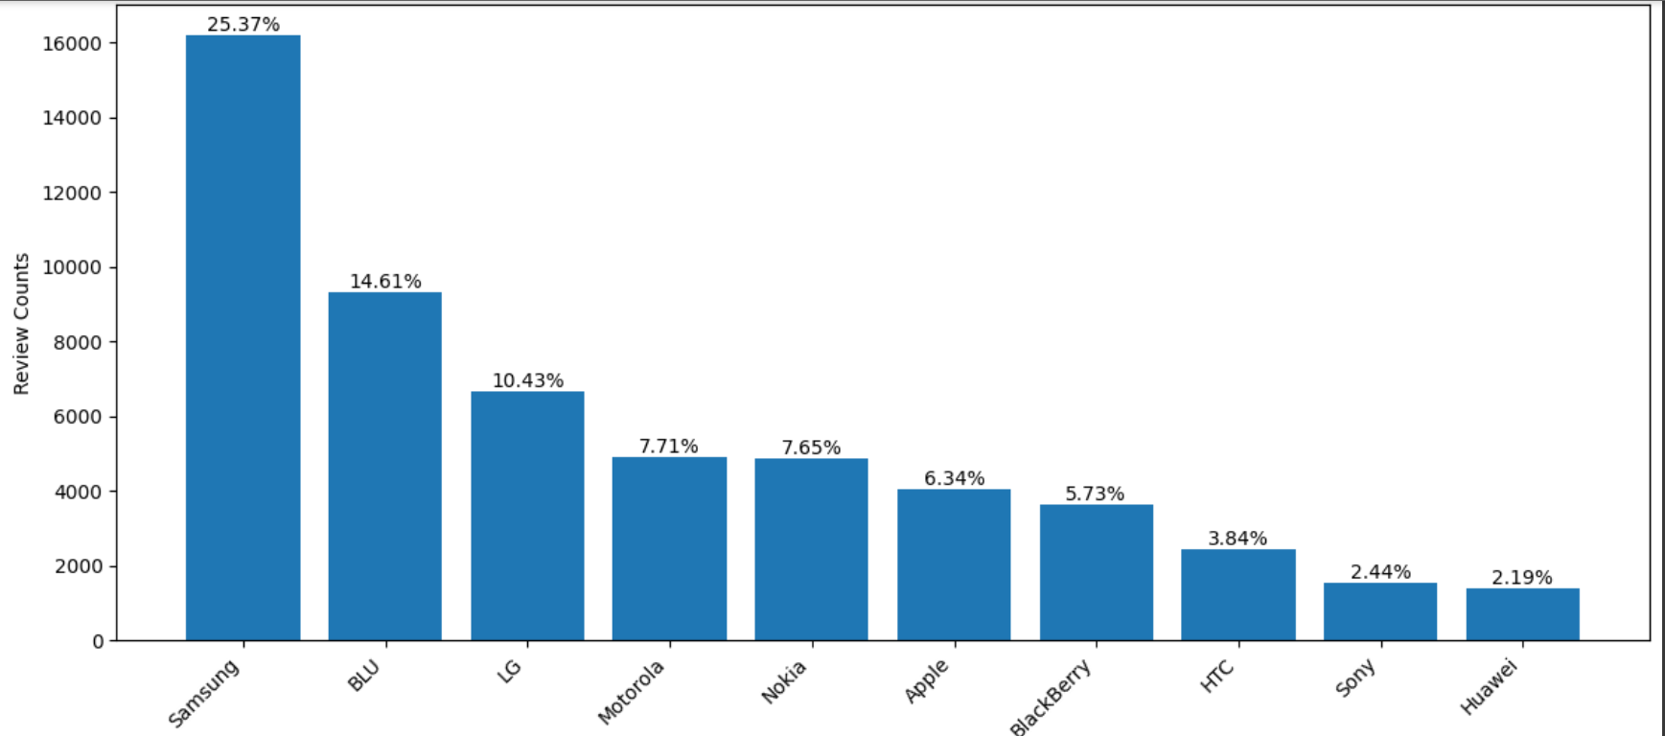
Most Reviewed Brands
‘Samsung’ is
the most reviewed
brand share.
with 25.37% of the review
Followed by ‘Samsung’ are ‘BLU’, ‘LG’, ‘Motorola’, ‘Nokia’ & ‘Apple’.
All the above 6 brands contribute to approx. 80% of reviews share.

Slide 7
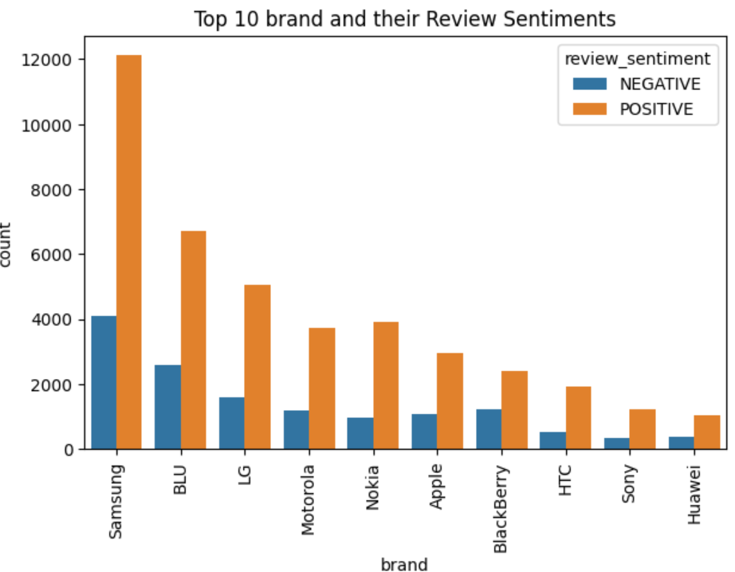
Verified Sentiment Reviews
As we saw the brands which have most reviews, they do have both positive and negative sentiments.
Majority of the reviews are are positive.
Based on the statistics and on the sheer amount of reviews, we can say that ‘Samsung’ is most preferred brand by the consumers.

Slide 8
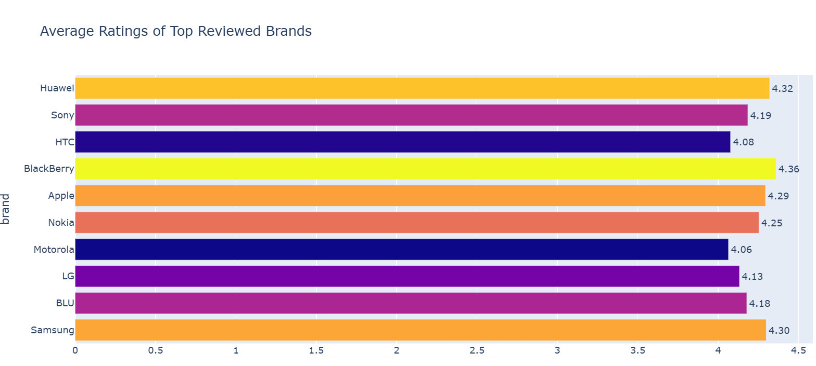
Average Ratings of Brands
‘BlackBerry’ is highly rated among all other brands followed by ‘Huawei’, ‘Samsung’, ‘Apple’, ‘Tracfone’ and ‘Nokia’.
Based on amount of reviews and verified positive sentiment reviews, leading brands in the market are ‘Samsung’, ‘Apple’, ’BLU’, ‘Huawei’ and ‘Nokia’.
A suggested action for the business is to closely observe and follow these brands, i.e., take a note of market strategies, Ad campaigns, websites, release patterns of new products, etc.

Slide 9
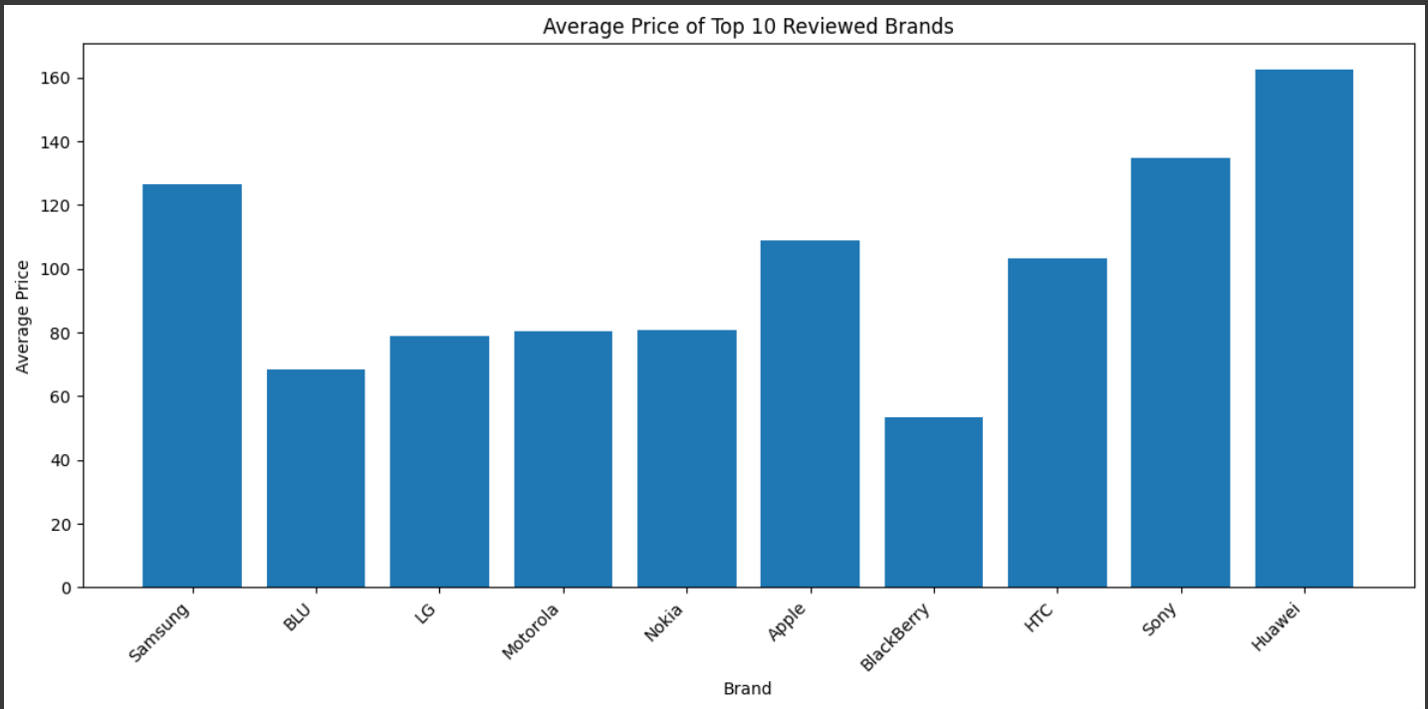
Average Price Ranges
‘Huawei’, ‘Sony’, ‘Samsung’,
‘HTC’ have higher
‘Apple’ and
prices on average among the top reviewed brands.
90$ is the average price for all the top reviewed brands together.
Price range of the top reviewed brands is actually is quite big, 44.80$ - 162.55$. So we need to pinpoint a better price range preferred by customers.

Slide 10
Preferred Price Ranges
Even though ‘Huawei’ & ‘Sony’ have better on average rating, the amount of reviews are quite low, hence people do like these phones but many avoid to buy due to the high prices.
A suggested action to the business is to try and keep the prices of their phones in ranges of 60$ - 120$.

Slide 11

Action Items
To closely observe and follow the top reviewed brands (‘Samsung’, ‘Apple’, ’BLU’, ‘Huawei’ and ‘Nokia’), i.e., take a note of market strategies, Ad campaigns, websites, release patterns of new products, etc.
To try and keep the prices of the phones in ranges of
60$ - 120$.
Keep up with latest market tech features to produce phones but at the same time keeping in mind of preferred price range.
To not dispose of the returned phones but instead refurbish and release it back to market by lowering the prices.

Slide 12
Appendix
Data Source - Amazon review data for different cell phones and accessories that were purchased between the years 1996 and 2018. The data set used in this project has been taken from this link and has been slightly modified for the capstone project (by UpGrad).
The tools used for the data understanding, analysis and drawing insights are Python with Google Colab Notebook and Tableau by Salesforce.

Slide 13


Thank You

